Slide 1

GOLANG
A step into a concurrent world

Slide 2





01
Why This Topic?

Slide 3
Concurrency Killer
Mass Industry Adoption
It’s known online as the “concurrency killer” or the “C++ killer”. Hearing such bold claims, our interests were piqued and our minds ready to learn.
Many Fortune 500 companies have started to use Go for a variety of tasks due to it's C style syntax, static typing. high performance and low latency garbage collection. We wanted to see what all the talk was about

Slide 4

Look At Him.

Slide 5
02
What Is Go?

Slide 6
Concurrency
Concurrency != Parallelism
Independent tasks that can execute at any time
Concurrent tasks can be parallelized, but not vice versa

Slide 7
03
Where Is Go?

Slide 8

Who Uses Go?
Uber
Twitch
Dropbox
Soundcloud
Apple
Docker
The New York Times
Google
SendGrid
1Password
Amazon
Capital One
Facebook
Amazon
Paypal
Microsoft
Alibaba
Medium
Netflix
Khan Academy
Github
Mozilla
CloudFlare
Digital Ocean
MongoDB
Heroku

Slide 9
04
How Is Go?

Slide 10
How goroutines work
Managed by go runtime
Small amount of memory
Threads are managed by the OS while goroutines are managed by the runtime
Each goroutine has about 2kb of memory, much less than a thread’s 1mb
Many routines in a thread
No hassle
Go spawns multiple routines inside a thread, pooling them together
$ go myfunc(arg1, arg2)

Slide 11
What’s the impact?
Caused massive speedups for multiple companies
Easier syntax, better reliability, and amazing scaling means faster and more secure development
Easy and lightweight concurrency increased overall scale of features all around

Slide 12
Testing Paradigm
Using the Monte Carlo Method to Estimate Pi
Points:
100
1,000
10,000
100,000
1,000,000
10,000,000
100,000,000
1,000,000,000
Threads:
2
4
8
16
32
64
Testing Go concurrency against C++ and Python

Slide 13
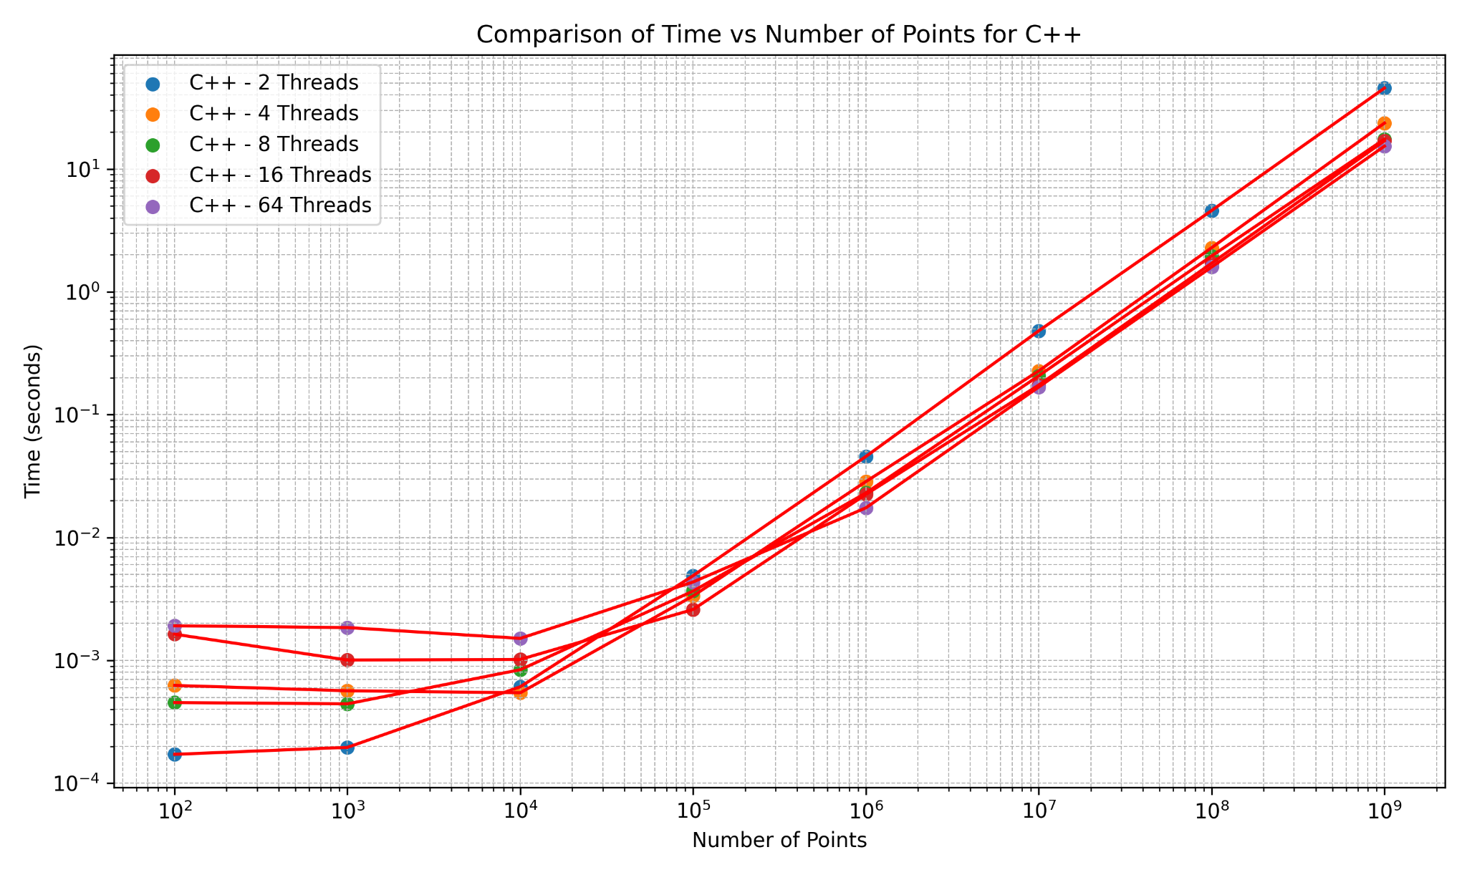
Performance Metrics - C++

Slide 14
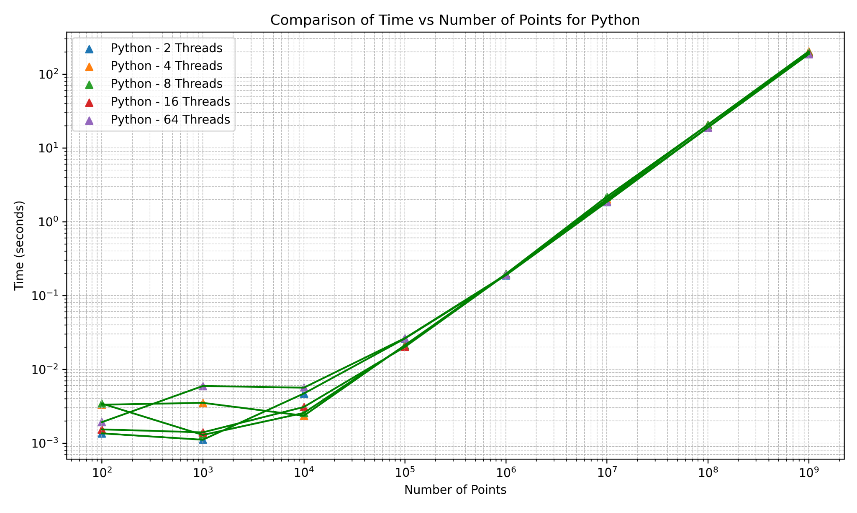
Performance Metrics - Python

Slide 15

Performance Metrics - Go

Slide 16
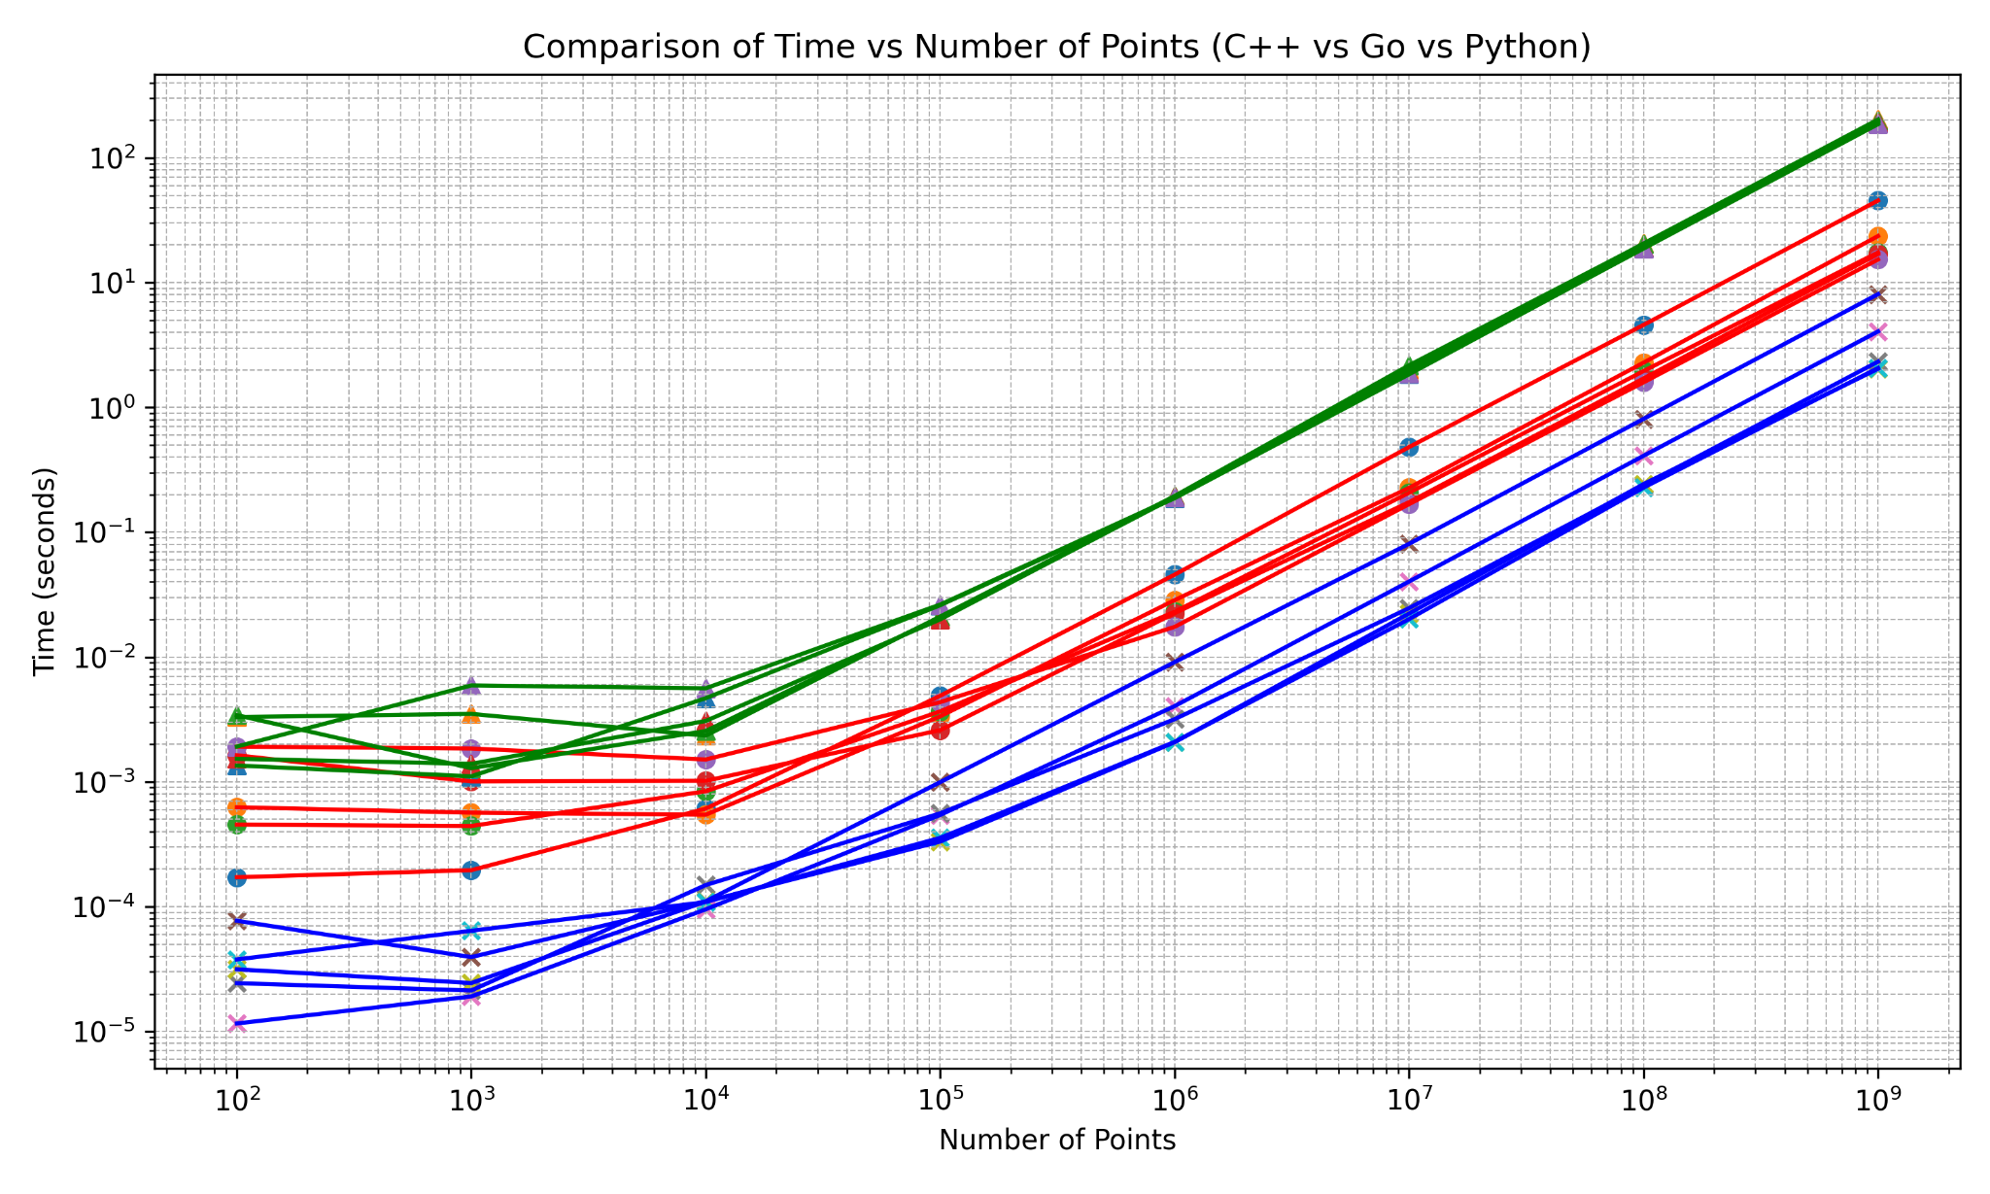
Performance Metrics - All

Slide 17
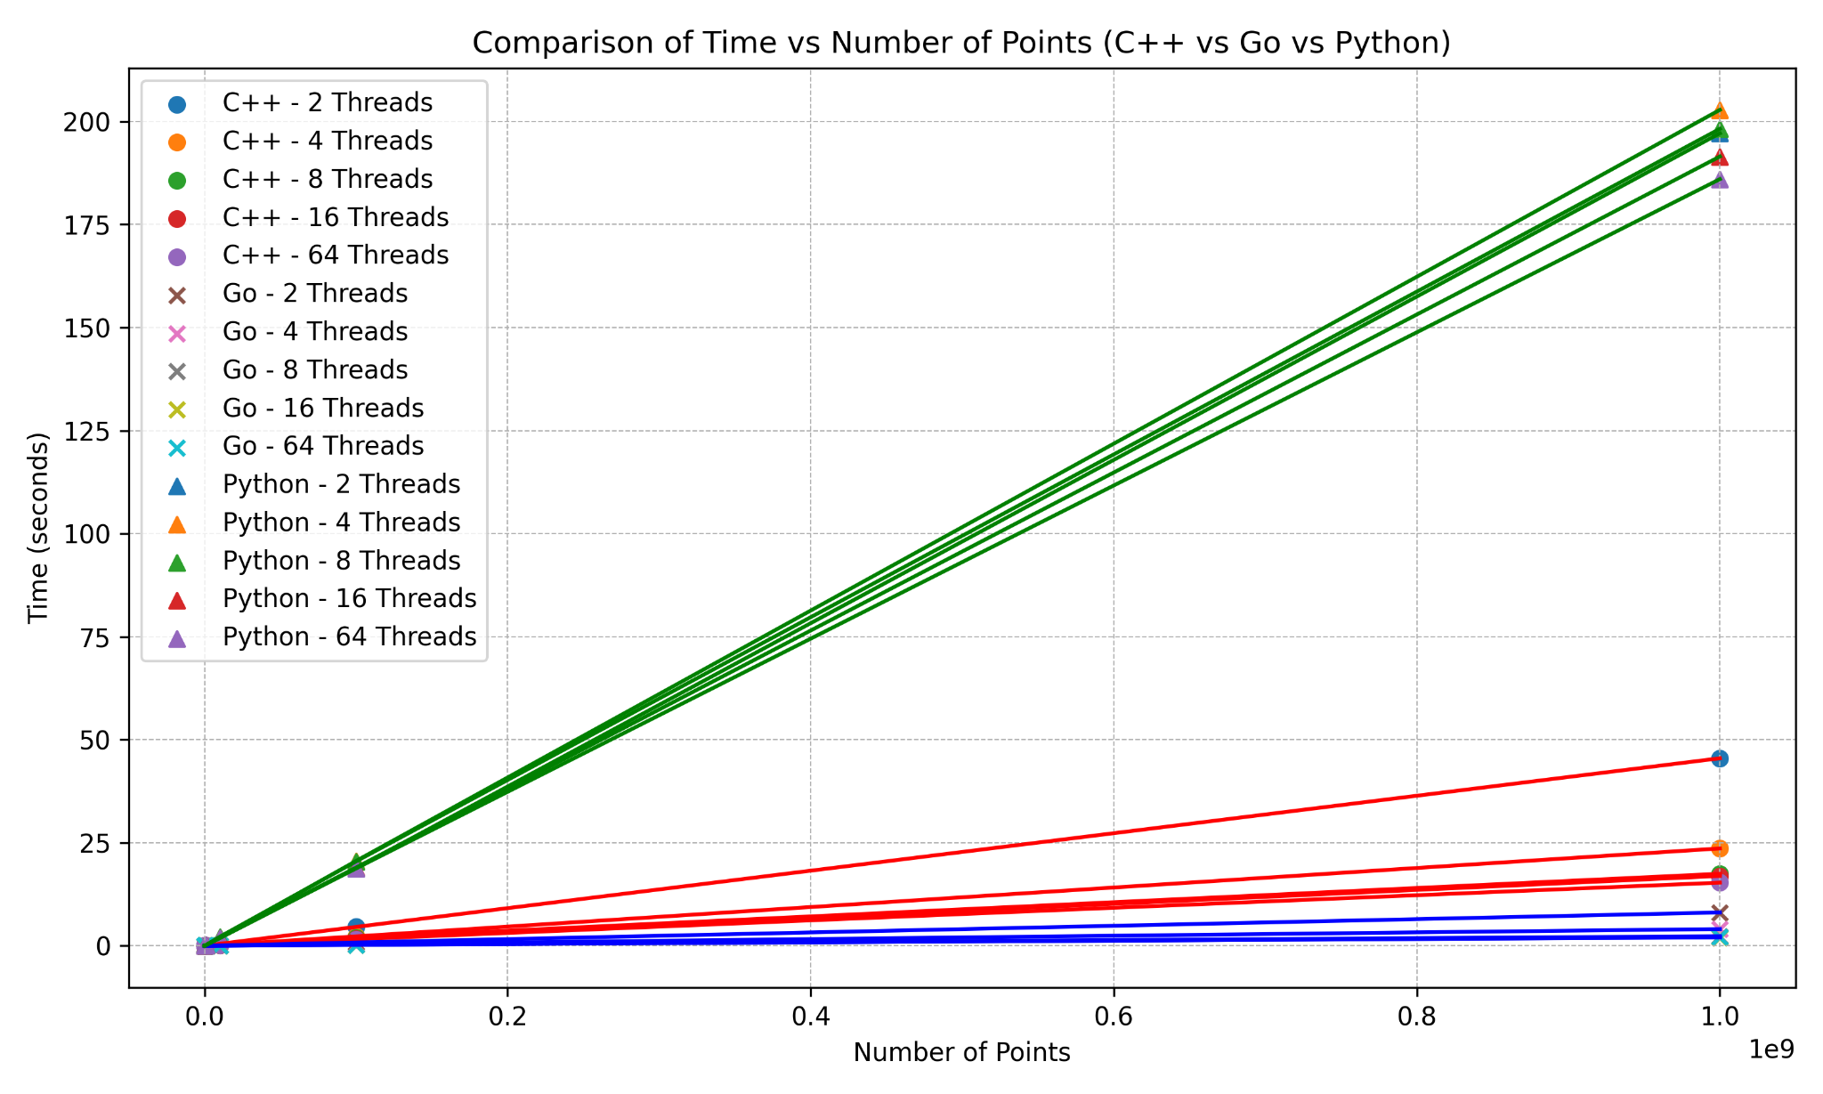
For a sense of scale…

Slide 18
A
Quick Demo

Slide 19
Technology Maturity
DEPENDENCY MANAGEMENT
TESTING LIBRARY
NETWORKING LIBRARY
A go.mod file is created for large projects to allow version trackers to maintain dependencies as well as import your module into other codebases seamlessly
Native testing module has very verbose support for creating unit tests and tracking anything you desire.
The native net library supports TCP and UDP connections, DNS name resolution, tls encryption, and much more with it's simple syntax
INTERNAL TOOLS
CONCURRENCY
Libraries like pprof, godoc, container , refactor , and copyright are included within the language to provide everything from documentation to performance analytics
Implemented in numerous production code bases. Boasts ultra low bandwidth and ultra high speed concurrency, leading to increases in throughput and maximizing profits.

Slide 20
THANKS!
Do you have any questions?
Repository: https://github.com/meap02/golang-performance-demo

